Slide 1
Introduction to R
Alexis Robert, Sophie Meakin, Naomi Waterlow and Billy Quilty
Based on a script and session developed by
Abigail Page, Claire Dooley, Anushé Hassan, and Shammi Luhar.

Slide 2
What is R?

Slide 3
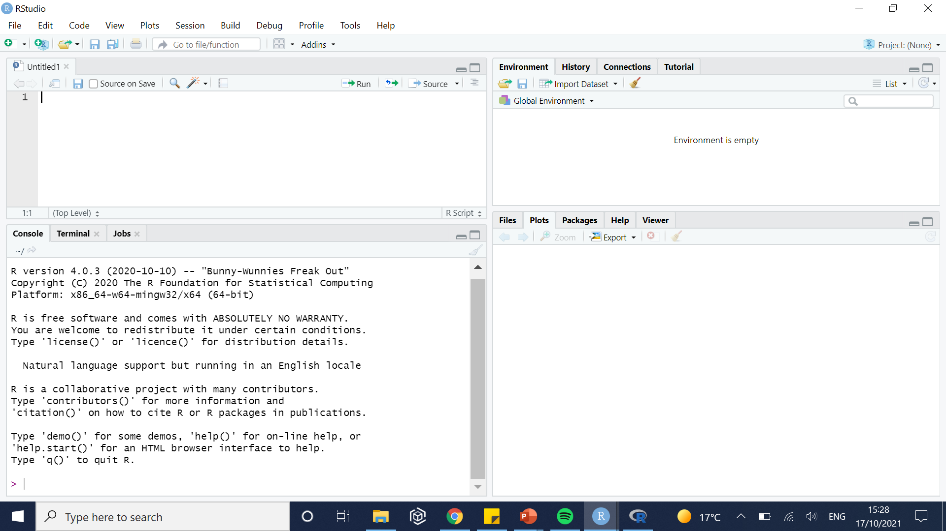
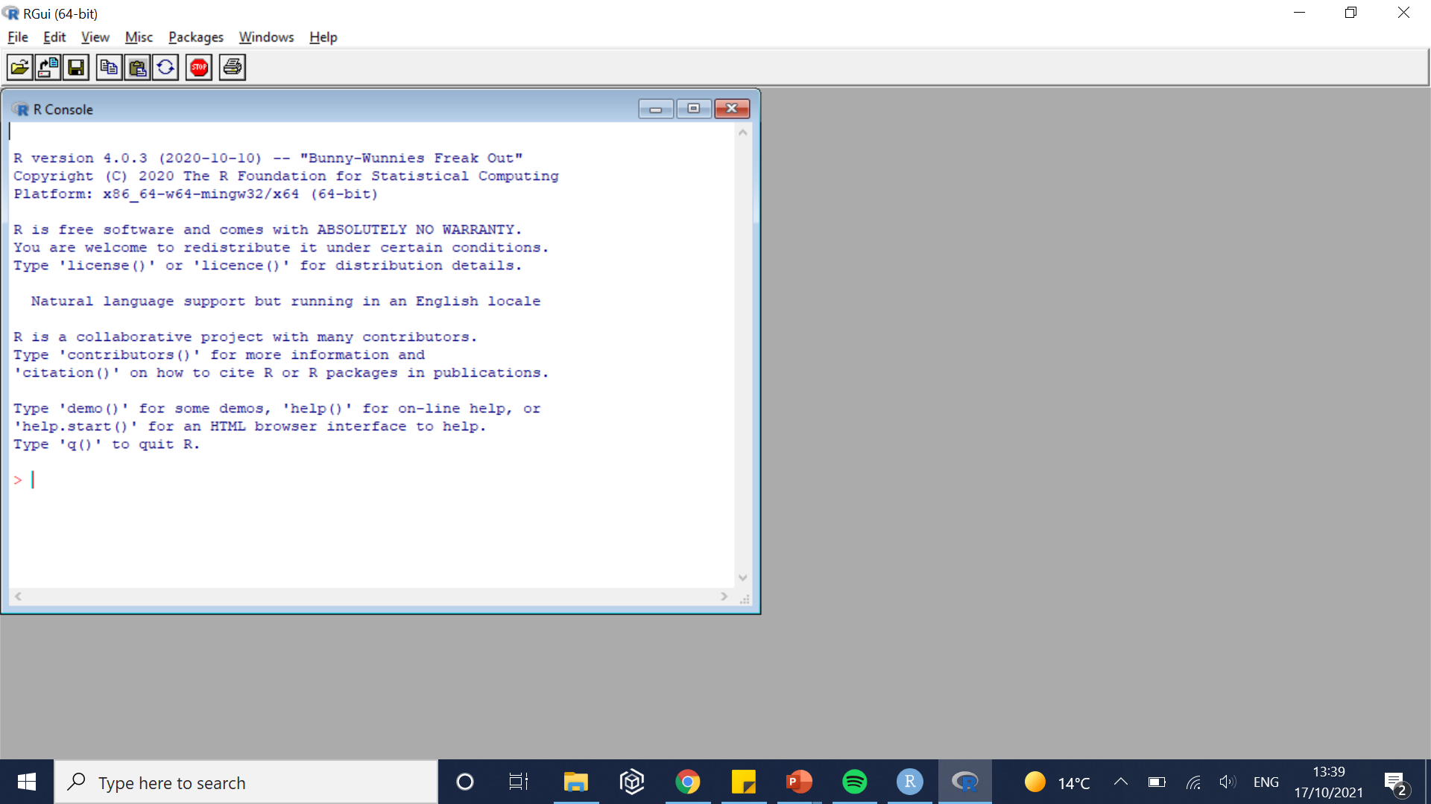
What is R, what is Rstudio?
R designates both the language and the software using this language
Similar to C, Fortran, Python…
R is (mostly) used for statistical computing (i.e. import, manipulate, analyse, and visualise data).
R has no graphical user interface.
RStudio is used as the graphical interface.

Slide 4
Why use R at all?
Free and open-source.
Versatile (packages developed for almost everything).
More intuitive than C / C++.
Highly popular:
Lots of learning resources.
Lots of forums / platforms providing help.

Slide 5
Why use R at all?
Cool extensions!
Data visualization
Dashboards e.g. with R Shiny
Automated reports

Slide 6

Data visualisation e.g. with ggplot2

Slide 7

Data visualisation e.g. with rayshader

Slide 8
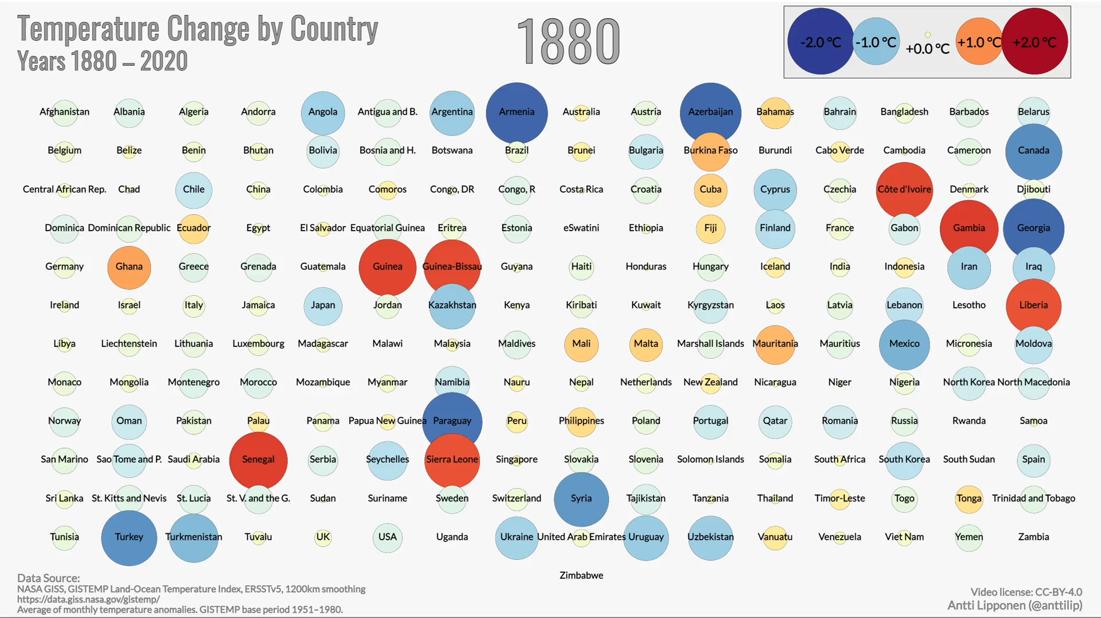
Data visualisation e.g. with ggplot2

Slide 9
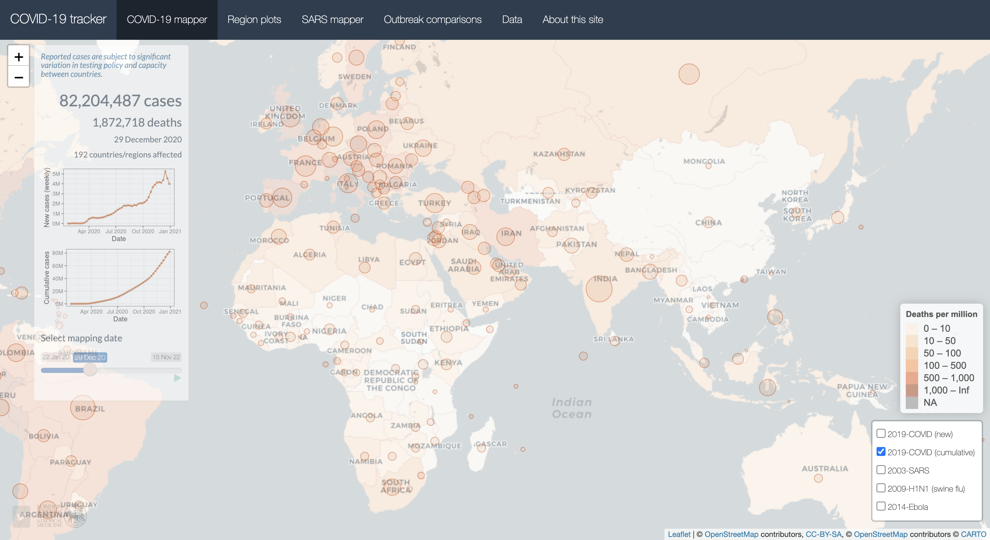
Dashboards e.g. with R Shiny
COVID-19 tracker R Shiny app

Slide 10
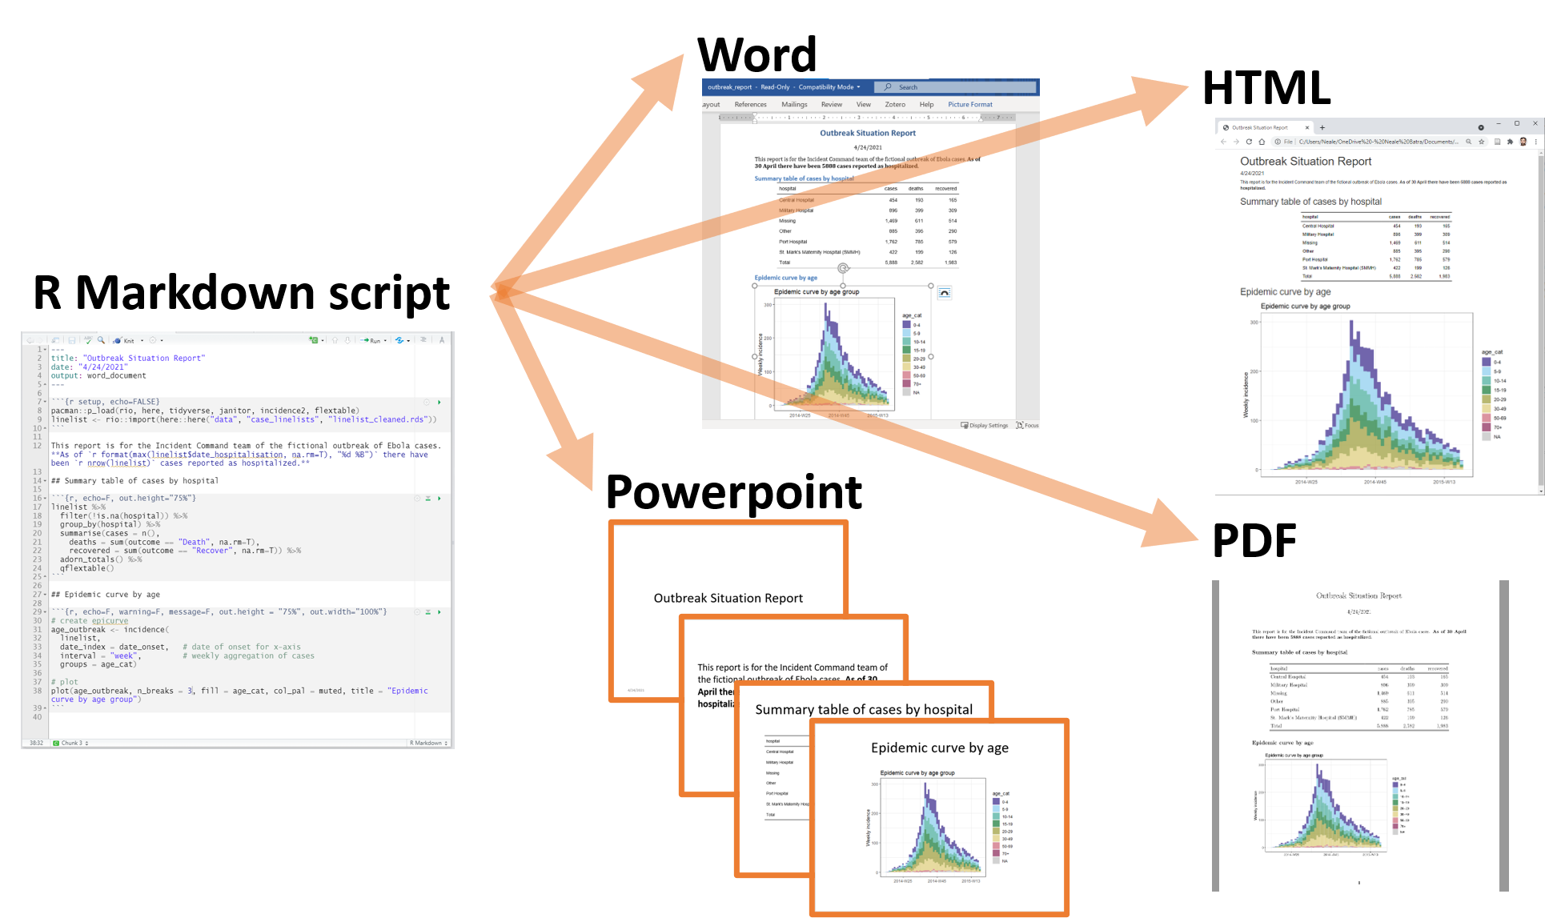
Automated reports with R Markdown
Image credit: The Epidemiologist R Handbook: Reports with R Markdown

Slide 11
Useful resources
https://stackoverflow.com/questions/tagged/r (questions related to R answered by the community)
https://cran.r-project.org/doc/manuals/r-release/R-intro.pdf (Very thorough introduction to R, useful if you need more information on a specific aspect)
https://r4ds.had.co.nz/index.html (R for data science)
https://www.rstudio.com/resources/cheatsheets/ (Cheatsheets to use certain packages)
https://www.epirhandbook.com/en/ (comprehensive introduction to R for applied epidemiology and public health)

Slide 12
Getting familiar with RStudio

Slide 13
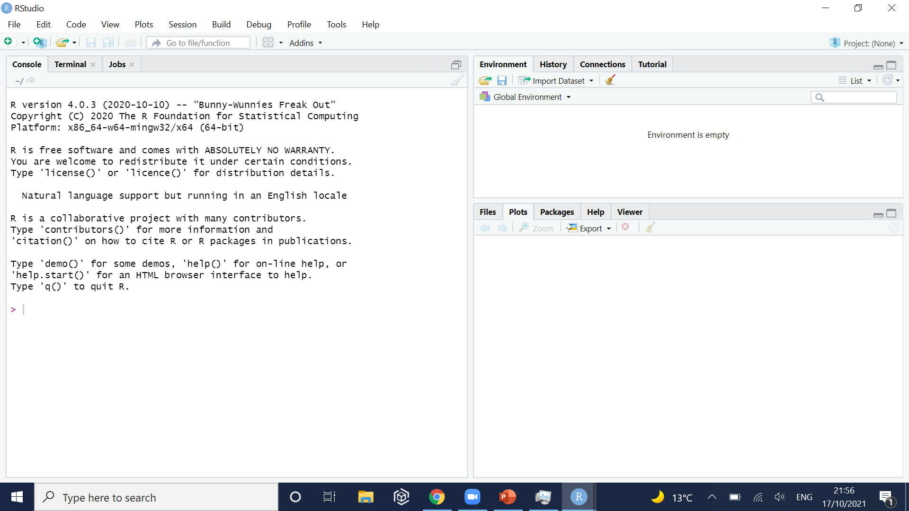
Opening RStudio and creating a new script
You can execute individual lines of code in this area, but it is more convenient to open a new script.

Slide 14
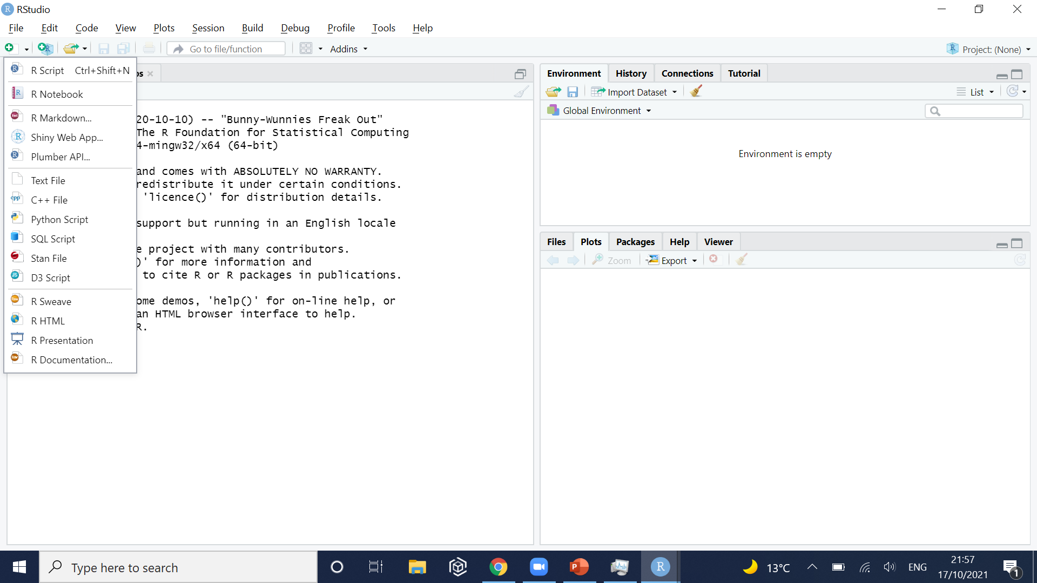
Opening RStudio and creating a new script

Slide 15
The new script is open!
Execute (i.e. run) the current line of your script
Area to write your script

Slide 16
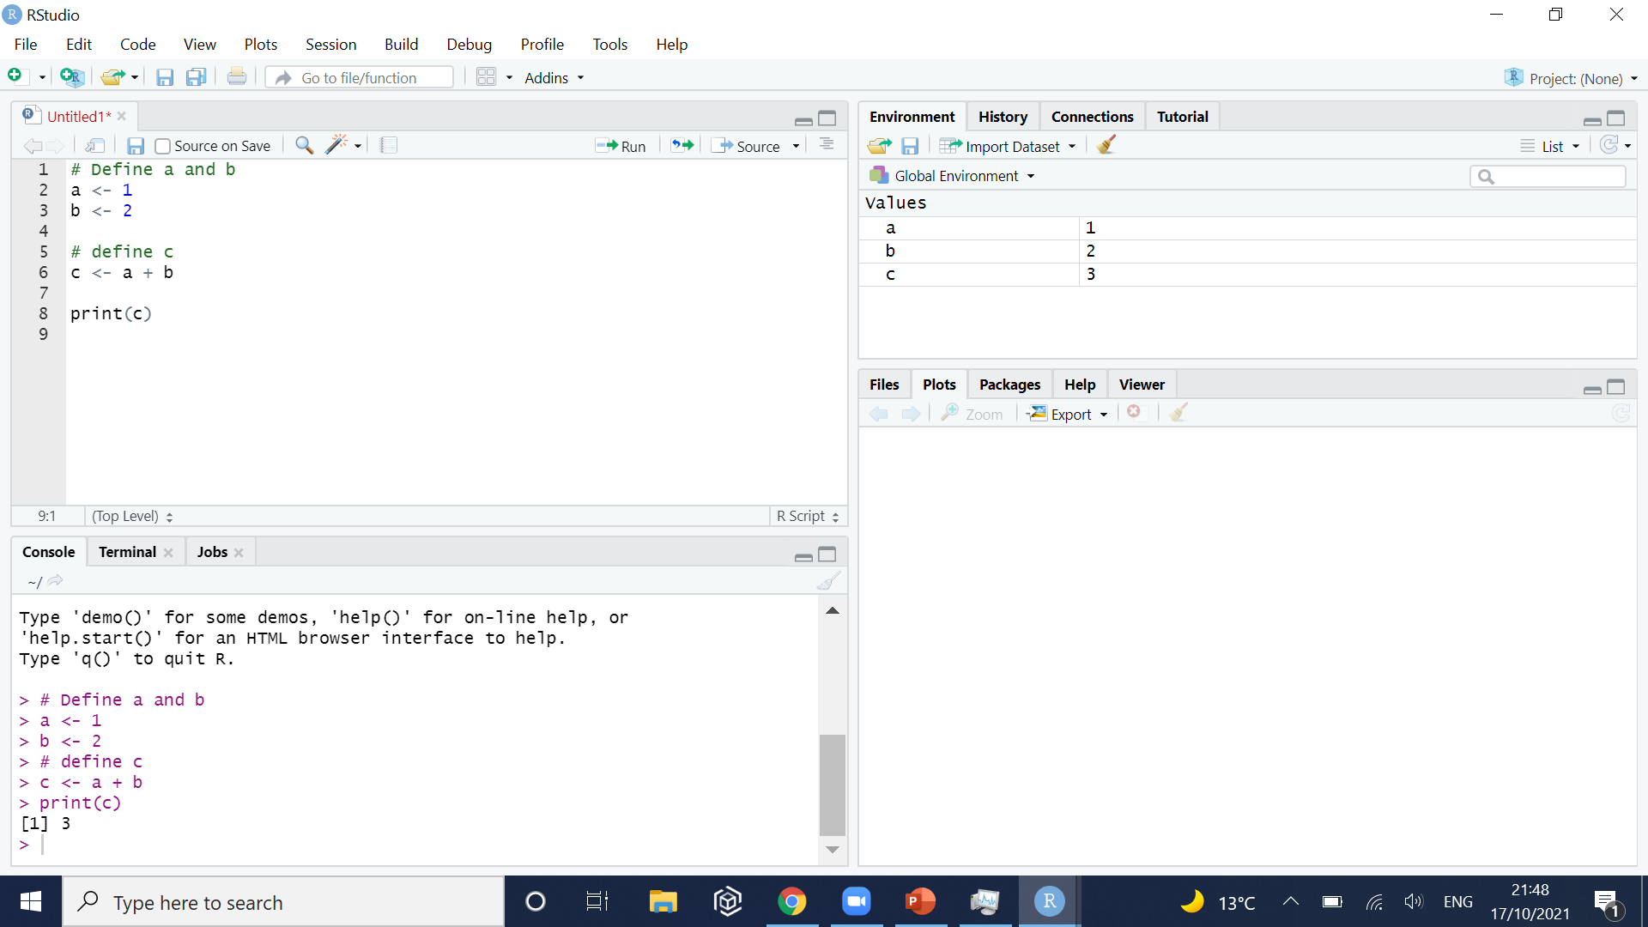
We can write and save the script
Environment:
Objects currently loaded in your session
Console:
Commands that have been executed are shown here

Slide 17
Opening a file

Slide 18
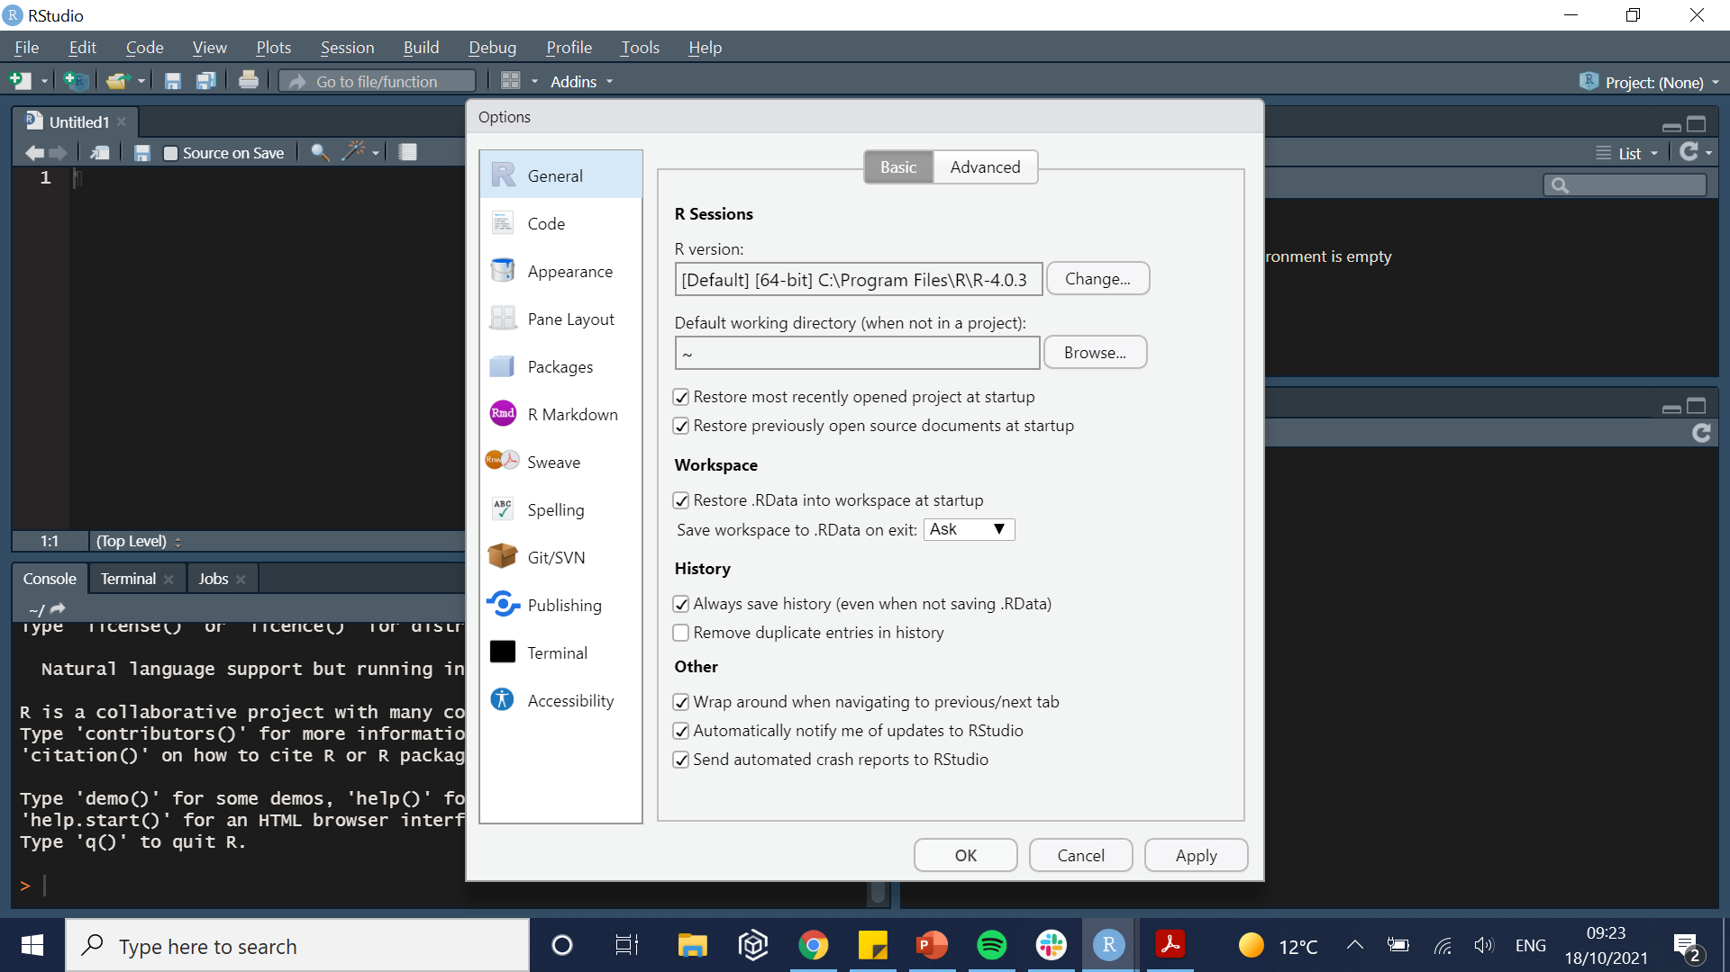
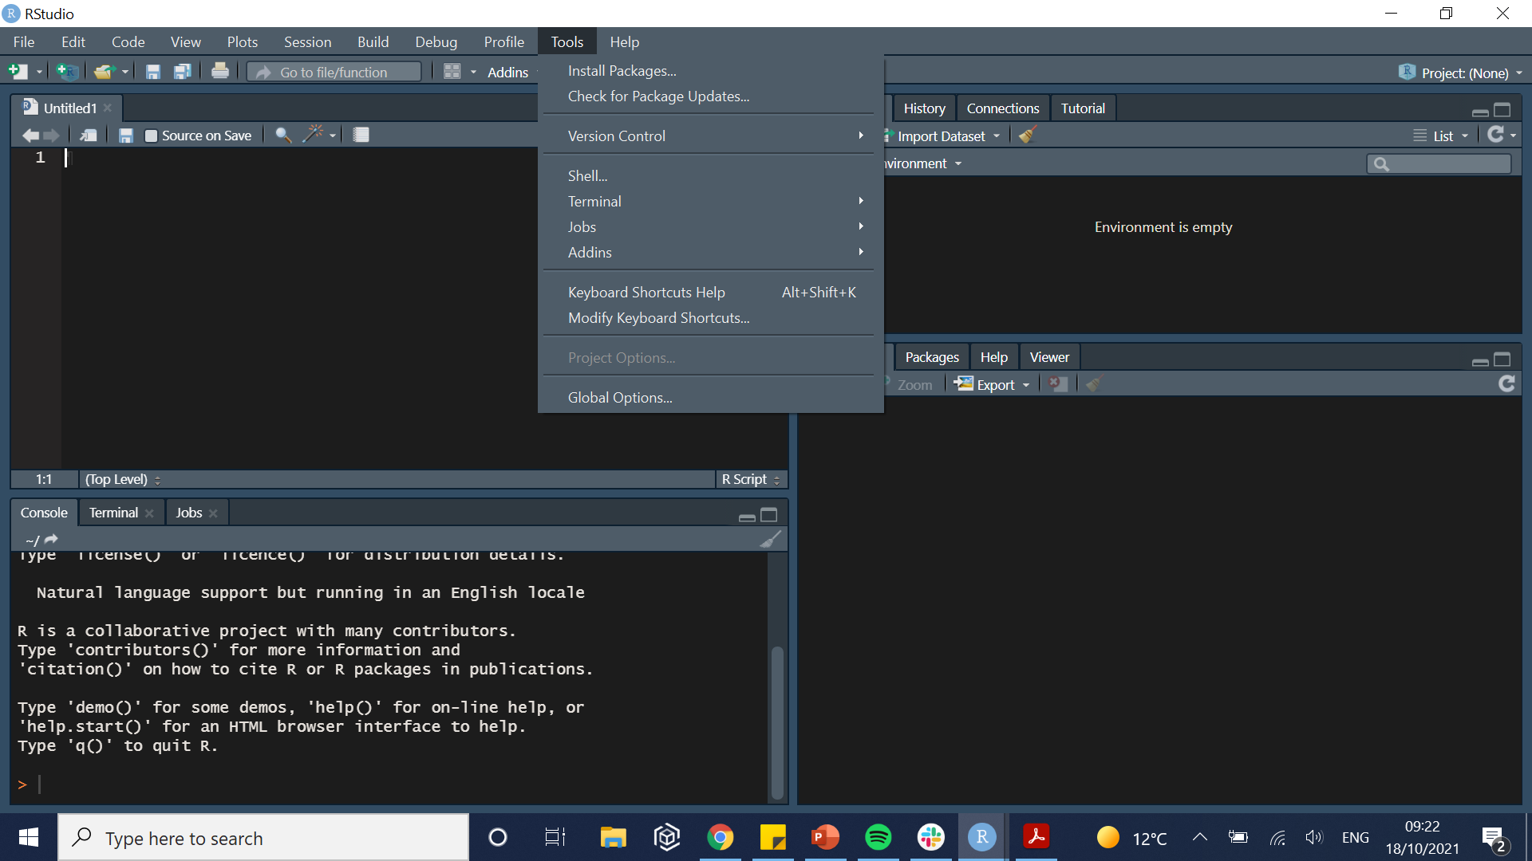
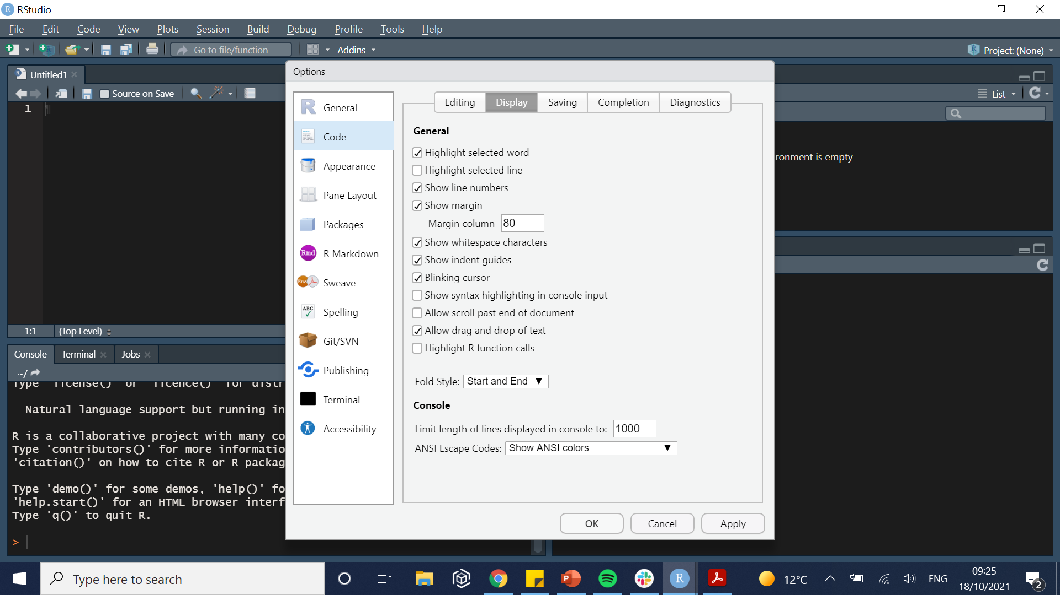
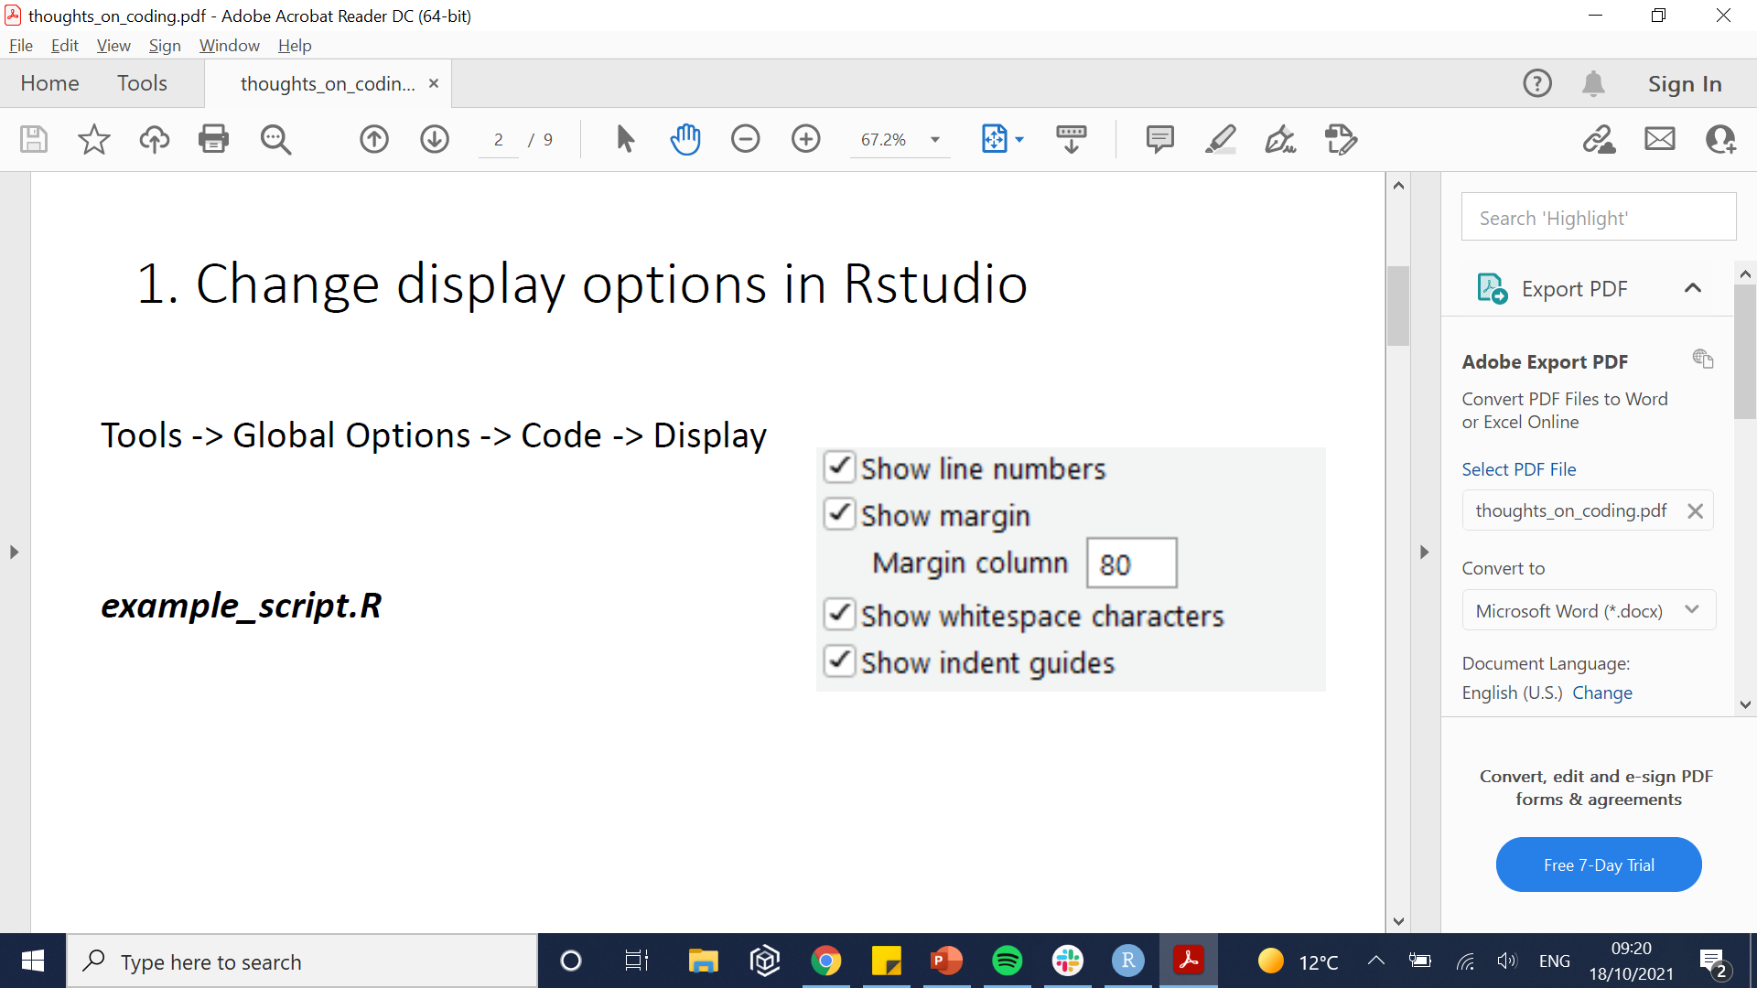
Change RStudio display options
Activate Dark Mode: Tools => Global options => Appearance => “Merbivore Soft”
Change code display: Tools => Global options => Code => Display

Slide 19
Practical

Slide 20
1/ Basic R expression
The most basic expressions are the same as would be anywhere else:
“+” to sum.
“-” to subtract.
“*” to multiply.
“^” to power.
“/” to divide.
Others have functions integrated in the base version of R
“sqrt()” for square root.
“exp()” for exponential.
“log()” for logarithm.

Slide 21
1/ Basic R expression

Slide 22
2/ Setting a new working directory
Create a new folder where you will put the scripts, data and outputs of these sessions.
Introduction_to_R
Script
Output
Data
Contains the R files you have written in this project (this folder is also sometimes labelled “R”
Contains the figures and analysis generated in the R scripts
Contains the was data used in this project

Slide 23
2/ The working directory
The concept of working directory exists in many coding languages.
Tell the computer where you are working.
Default: getwd()
Documents
R
Introduction_to_R
Script
Output
Data
Downloads
Images
Music
getwd()
Introduction_to_R
Script
Output
Data
setwd(“Documents/R”)

Slide 24
2/ Alternative working directory: R Project
Why use projects?
Code sharing:
Not everyone uses the same path to directory
Default: getwd()
Documents
R
Introduction_to_R
Script
Output
Data
Downloads
Images
Music
getwd()
Introduction_to_R
Script
Output
Data
setwd(“Documents/R”)

Slide 25
2/ Alternative working directory: R Project
Why use projects?
Code sharing:
Not everyone uses the same path to directory
Default: getwd()
Documents
LSHTM
Introduction_to_R
Script
Output
Data
Downloads
Images
Music
setwd(“Documents/R”)
ERROR

Slide 26

2/ Alternative working directory: R Project
These problems are fixed by creating an R project (i.e. an .Rproj object):
Opening the Rproj object in R will put you in the right working directory.
Think of it as a “suitcase” containing all the information needed for a project.
Introduction_to_R
Script
Output
Data
Intro_to_R.Rproj

Slide 27
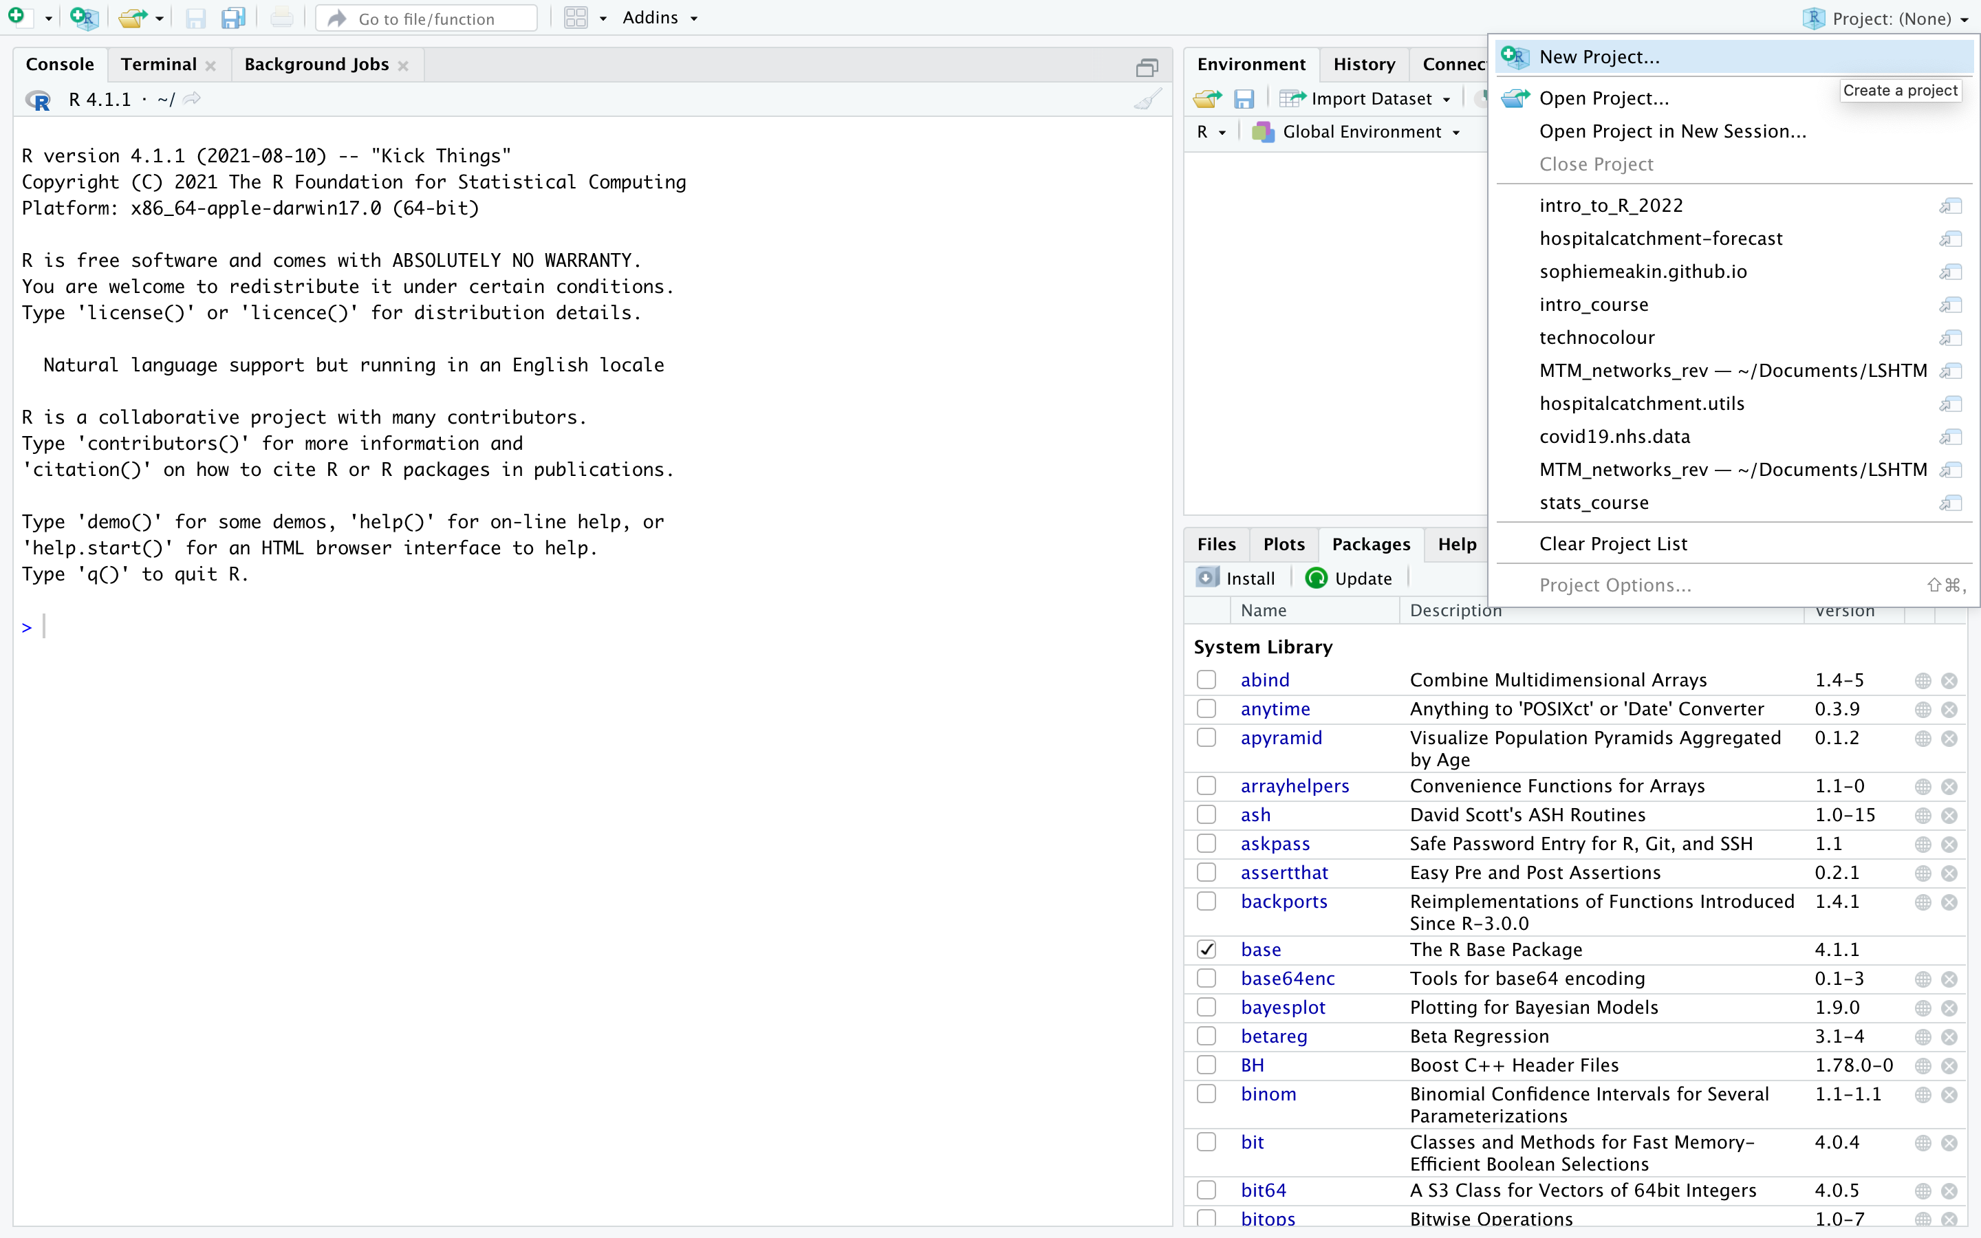
2/ Alternative working directory: R Project
How to create a new project

Slide 28
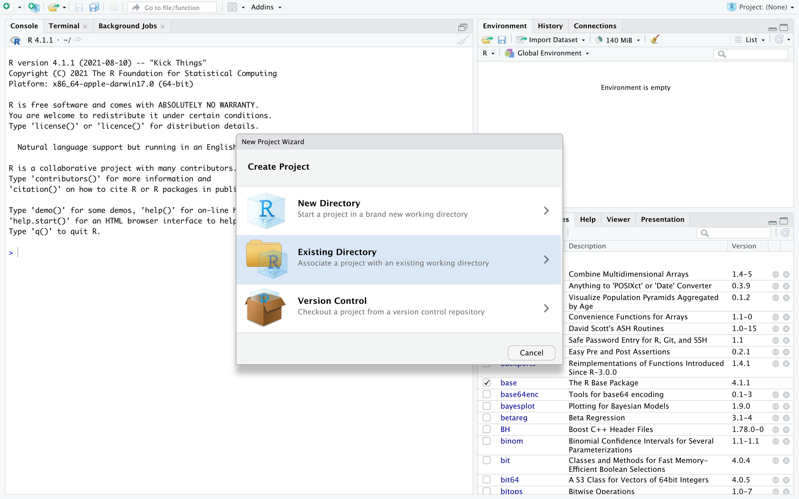
2/ Alternative working directory: R Project
How to create a new project

Slide 29
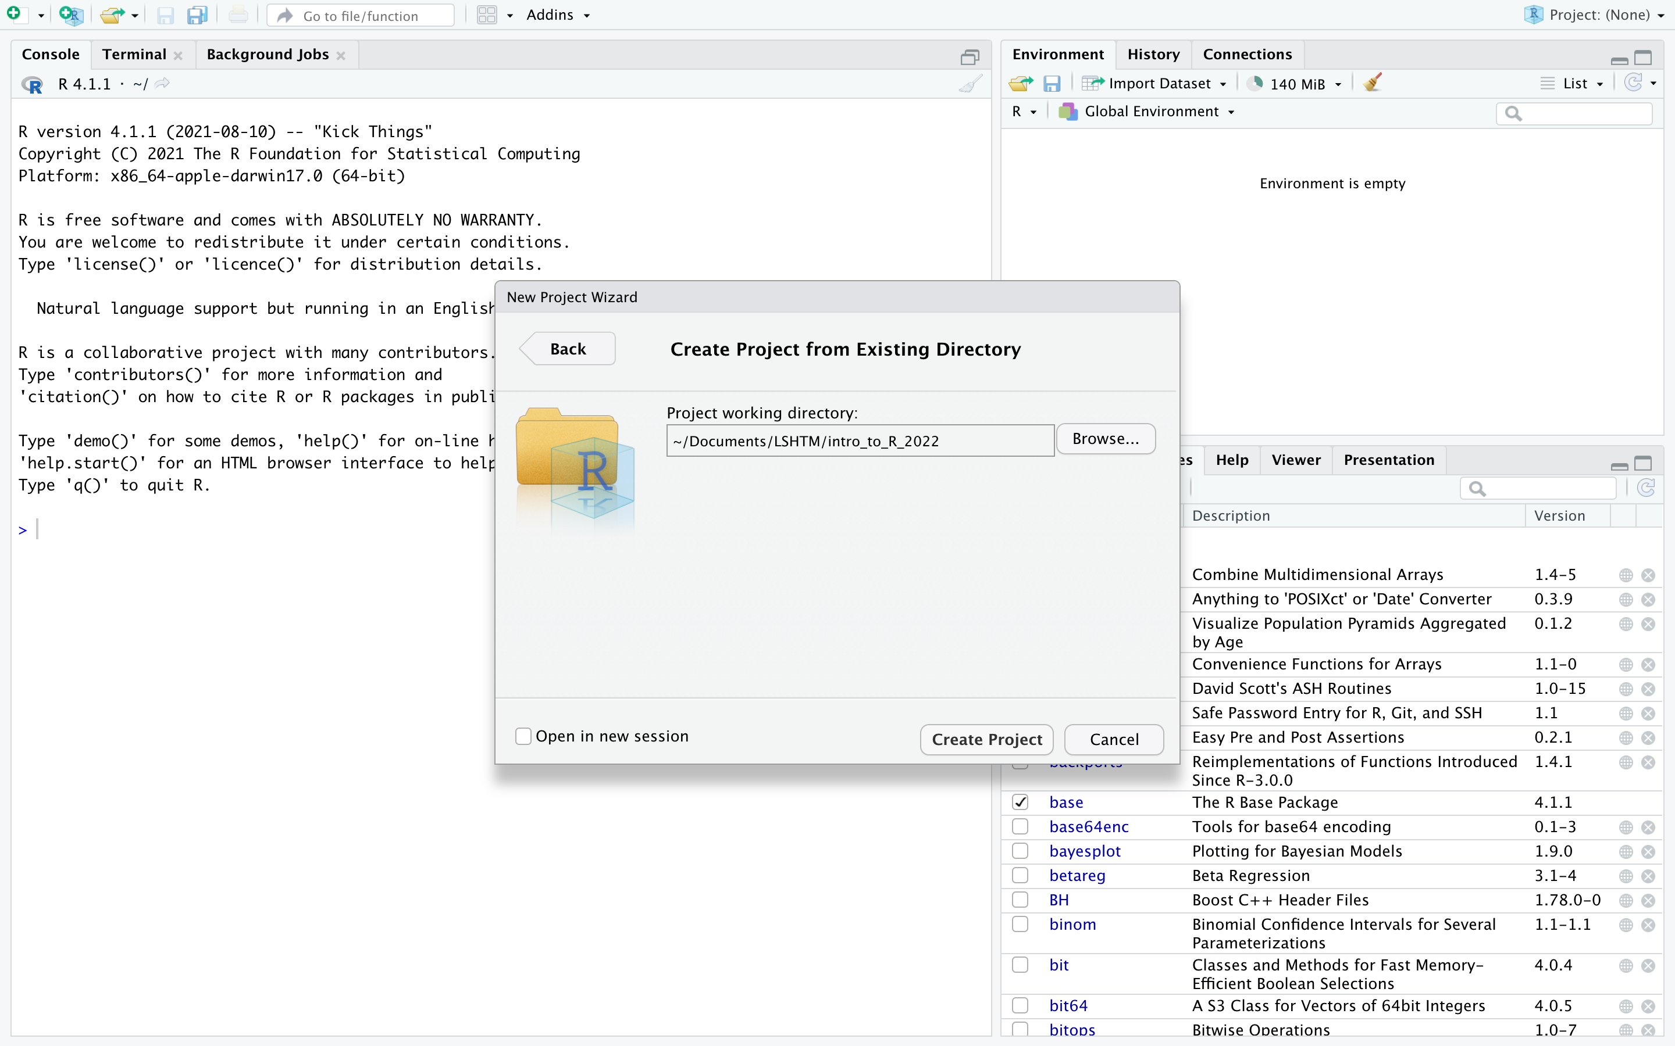
2/ Alternative working directory: R Project
How to create a new project

Slide 30
3/ Importing data
Importing (i.e. loading) data into R allows you to clean, analyse and visualise them without modifying the original data file.
The function import() can import all common data formats (e.g. .csv, .txt, .xlsx)
import(file = here(“data”, “my_data.csv”)) imports the csv file “my_data.csv”.
The function here(“data”, “my_data.csv”) tells R to look for the file called “my_data.csv” inside the folder “data” starting from the folder where the Rproj file is.
You may also see other functions such as read.table(), read.csv() or read.xlsx().

Slide 31
3/ Exporting data
Exporting data refers to the process of saving data from R to your computer.
The function export() can export all common data types.
export(x = my_data, file = here(“data”, ”my_exported_data.csv”)) exports the object my_data as a file called ”my_exported_data.csv” in a folder called “data”.
You may see other functions used to export data, such as write.table().

Slide 32
4/ Data types and objects
There are five main data types that you will frequently come across in R:
Character: “a”, “hello”
Numeric: 2, 2.1, pi
Integer: 2L, 9:100.
Logical: True, False
Complex: 1+0i, 1+4i
The function “class()” can be used to tell you the type of a given object.

Slide 33
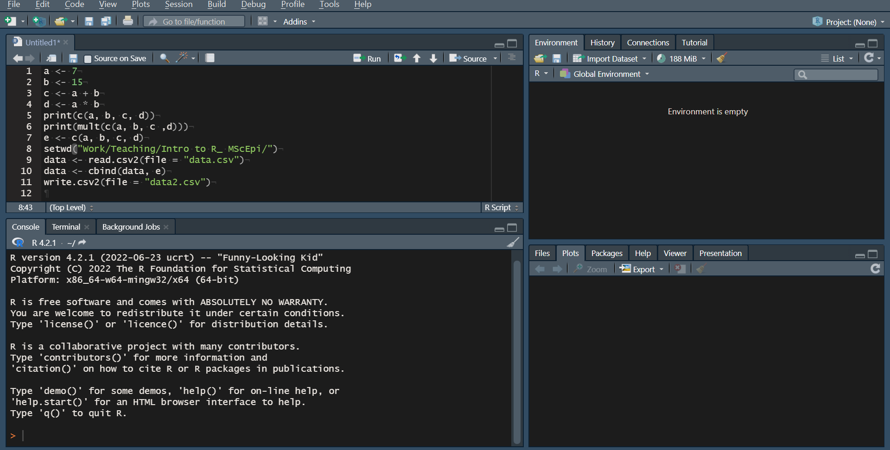
Good practices in coding: Commenting and spacing
Hard to understand what the script does without commenting and spacing.

Slide 34
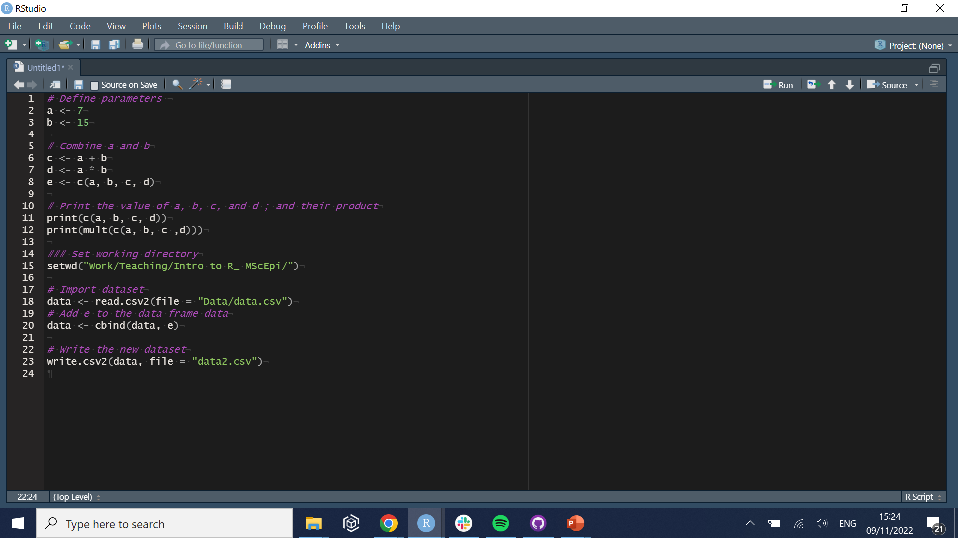
Good practices in coding: Commenting and spacing
Add commented lines, starting by “#” (they will not be executed by R).

Slide 35
Practical
Go through sections 1 and 2 of the practical.
The main commands are given in the documents, try and manipulate the data and function to make sure you understand how they work.

Slide 36
5/ Datasets
Datasets (i.e. objects containing data) can take different shape:
Vectors: Contain only one variable per element.
Matrices: Can contain several variables per element.
Data frame: Can contain several variables per element, of different types.
Base functions are used to compute the mean, median, or summary of a given dataset.
“mean()”
“median()”
“summary()”
“quantile()”

Slide 37
Vectors
Vectors contain a number of elements, usually of the same class.
A vector is constructed using the function ‘c()’
‘vec <- c(1,2,3)’ initialises a numeric vector, called vec, that contains three elements.
‘vec <- c(“a”,”b”,”c”)’ initialises a vector of characters, called vec, that contains three elements.
Values of a vector are accessed using brackets ‘[ ]’:
‘vec[3]’ designates the third element of the vector ‘vec’.
‘vec[-3]’ returns the vector ‘vec’ minus the third element.
‘vec[length(vec)]’ designates the last element of the vector ‘vec’.
1 | 2 | 3
“a” | “b” | “c”

Slide 38
Matrices
A matrix is a two-dimensional group of vectors, containing elements of the same class.
A matrix is constructed using the function ‘matrix()’, which needs 3 arguments:
‘data’: the values of the elements (by default set to NA).
‘nrow’: the number of rows (default to 1).
‘ncol’: the number of columns (default to 1).
‘mat <- matrix(c(1,2,3,4), nrow = 2, ncol = 2)’ initialises a matrix, called ‘mat’, with 2 rows and 2 columns:
‘mat[1,2]’ will return the element on the first row, and second column.
1 | 3
2 | 4

Slide 39
Dataframes
Dataframes are similar to matrices, except that they can contain multiple data types.
Especially convenient for storing data sets since it can combine characters (e.g. IDs, name, gender..), numeric (e.g.: age, salary…), dates etc..
They are created using the command ‘data.frame()’
Their elements can be accessed in the same way as matrices, plus specific functions.

Slide 40
6/Describing data
Many functions can help you summarise a dataset, whether it is a vector, matrix, or a dataframe.
‘length(x)’ (if x is a vector), or ‘dim(x)’ (if x is a matrix) indicates the number of elements if x.
‘head(x)’ prints the first 6 elements of the object x, useful to get more familiar with the dataset.
Columns in matrices can have names describing the variable it contains
‘names(x)’ shows the names of each column in x
For matrices, the operator ‘$’ is used to access a given column of a matrix
Running ‘X$height’ will show the column ‘height’ of the matrix X.

Slide 41
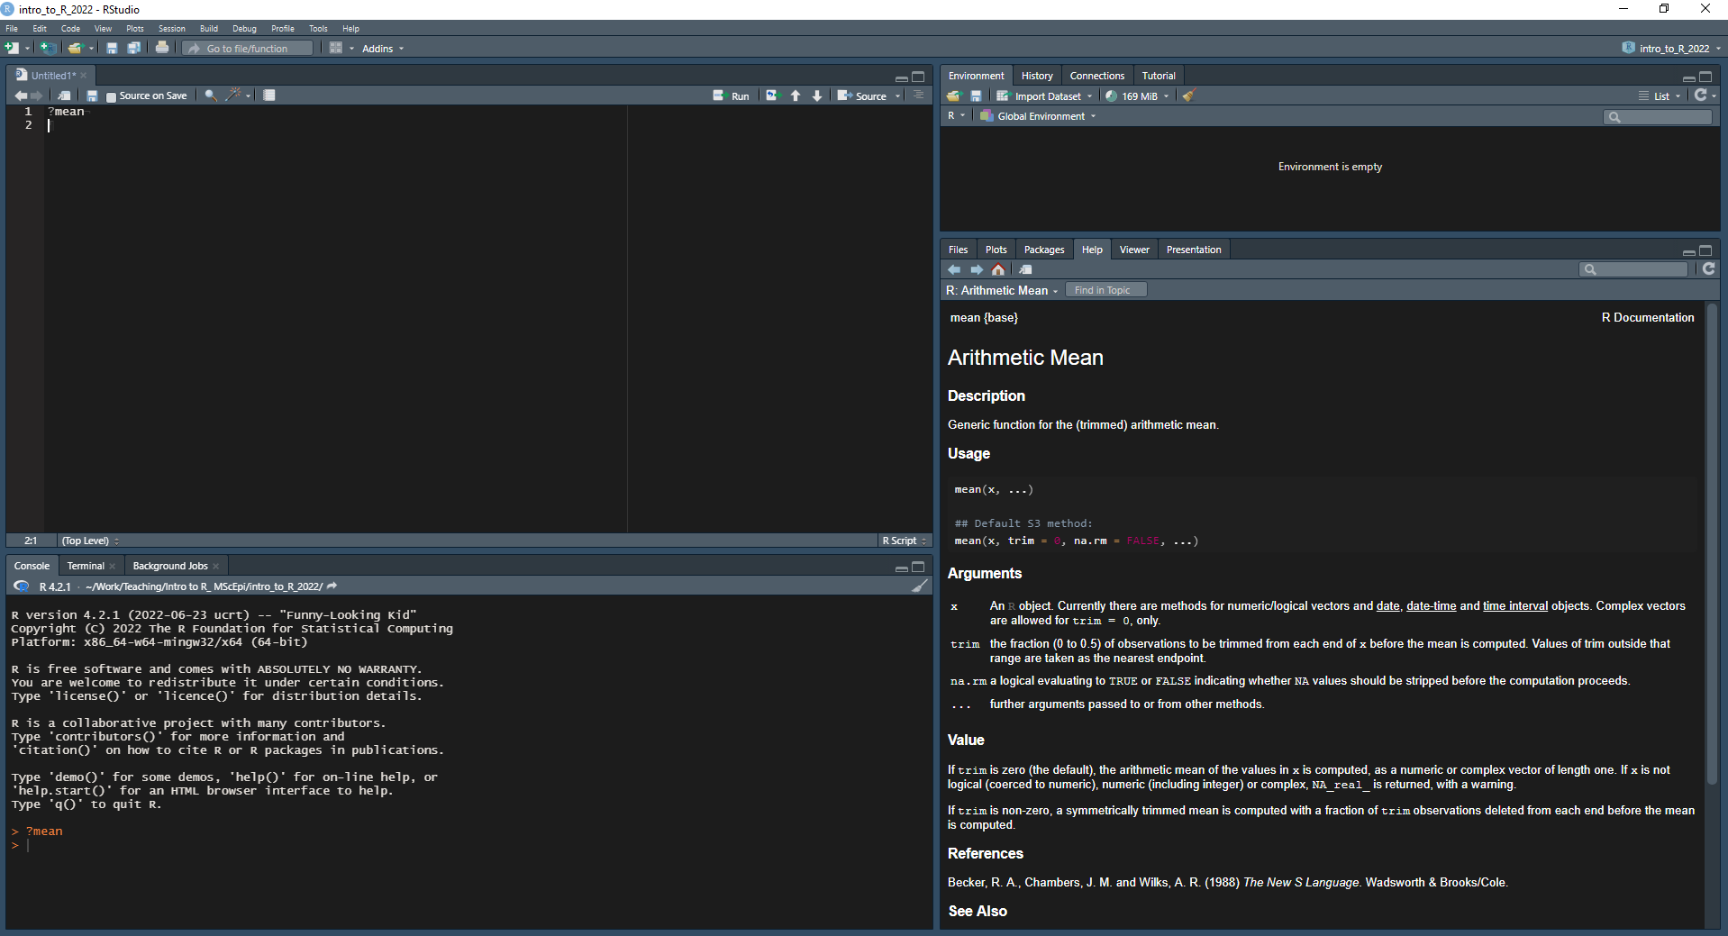
Helpfiles describe the arguments and outputs of functions
Use helpfiles to see a description of the expected arguments and output of a function, using the operator `?` (e.g. `?mean`).

Slide 42
Helpfiles describe the arguments and outputs of functions
If helpfiles do not clarify the use of a function, look up the name of the function on Google (along with the error message if you are debugging).
The online R community is very active and there are many posts and resources to understand the use of functions / why a part of the code is not running.

Slide 43
Practical
Finish the practical.
The main commands are given in the documents, try and manipulate the data and function to make sure you understand how they work.

